Slide 1
Unit testing
Test cases :
Loading model
Generating predictions
Generating tracks
Writing to video

Slide 2
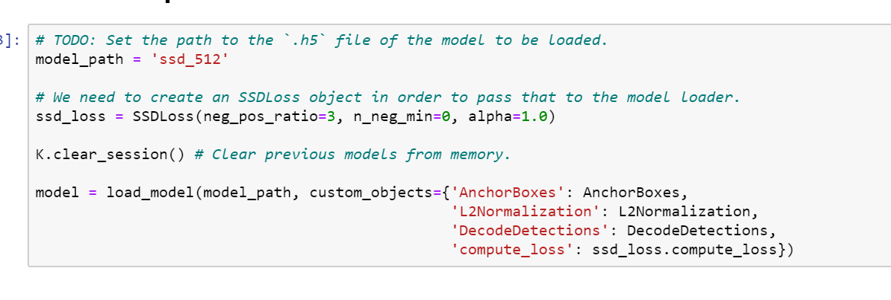
Model loaded succesfully

Slide 3
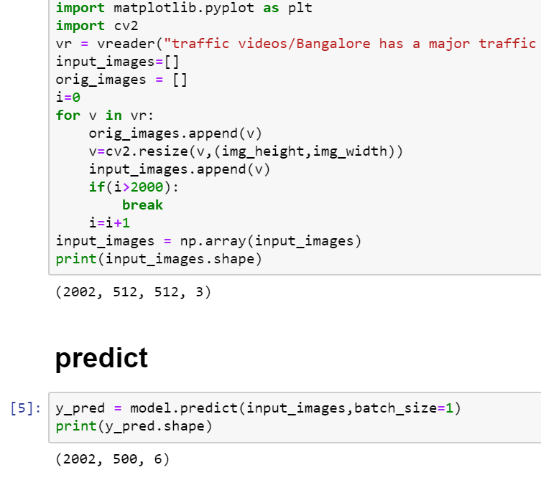
Model generated predictions for 2000 frames

Slide 4
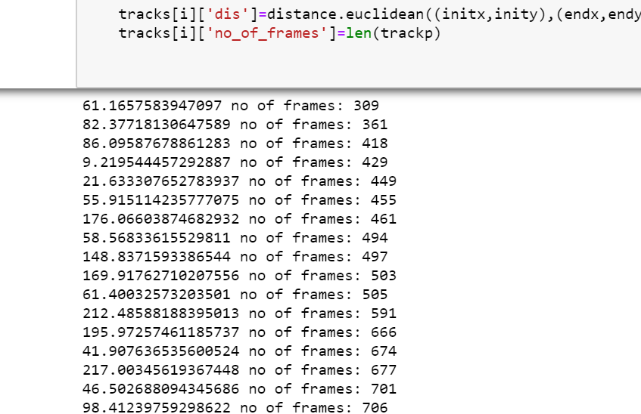
Computed tracks

Slide 5
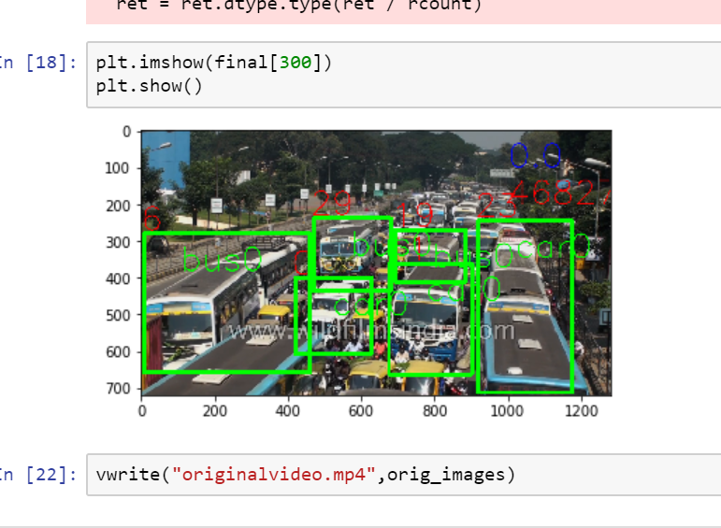
Generated output video

